Slide 1
Iris Species Classifier
AI Lab No 4
From: M Haroon Abbas (2K23/BLCS/ 38)
Course Instructor: Dr Fozia Talpur

Slide 2
Iris Dataset Overview
150 samples, 3 classes: setosa, versicolor, virginica
4 numeric features: sepal length, sepal width, petal length, petal width
Task: Multi-class classification (predict 1 of 3 species)
Balanced dataset with 50 samples per class

Slide 3
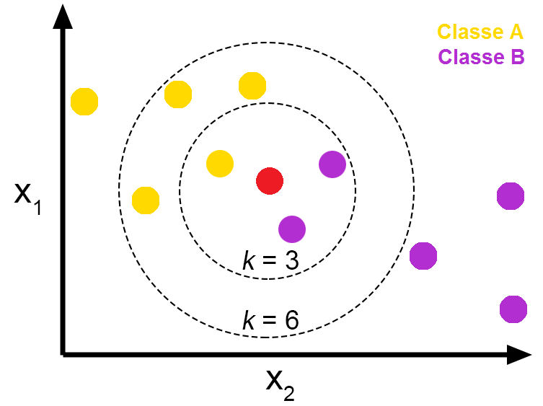
What is KNN?
K-Nearest Neighbors: Instance-based learning algorithm
Compute distance to all training points
Pick the closest k neighbors
Use majority vote of their labels as prediction
Uses predict_proba() to estimate class probabilities
from neighbors' votes

Slide 4
Why KNN for Iris?
Very intuitive for beginners ("nearest flowers vote")
Works well on small, clean, numeric datasets like Iris
Almost no training time; cost is at prediction time
Great to demonstrate feature scaling and choosing k

Slide 5
Why Scaling Matters
Feature scaling is critical for KNN:
KNN relies on distance (Euclidean)
Features with larger ranges dominate distance if not scaled
Solution: StandardScaler (mean ≈ 0, std ≈ 1)
We use Pipeline: StandardScaler + KNeighborsClassifier

Slide 6
Data Split Strategy
Train / Validation / Test with stratification:
Train: 70% — fit the model
Validation: 15% — tune n_neighbors (k = 3, 5, 7, 9, 11)
Test: 15% — final, unbiased performance estimate

Slide 7
Model Creation Pipeline
Load data with load_iris()
Split into train/val/test with stratification
Build Pipeline: StandardScaler + KNeighborsClassifier
Loop over k values, pick best on validation accuracy
Retrain best KNN on Train + Val combined

Slide 8
Evaluation Report
Test set performance:
Test accuracy: 95.65%
Only 1 misclassified sample (virginica → versicolor)
Macro F1 score ≈ 0.958
All per-class metrics (precision/recall/F1) are high
The final KNN model (K=3) achieved 95.65% accuracy on the test set. Setosa and Versicolor were classified perfectly, while one Virginica sample was misclassified as Versicolor due to overlapping feature characteristics. Overall precision, recall, and F1-scores indicate excellent model performance.

Slide 9
Saving the Trained Model
Model persistence with Joblib:
Save: joblib.dump(pipeline, "iris_knn_pipeline.joblib")
Load in FastAPI: model = joblib.load("...")
Pipeline includes both scaler and KNN
Ensures safe and consistent predictions

Slide 10
Deployment Ready
High accuracy + strong macro F1 = reliable classifier
Complete pipeline: dataset → model → evaluation → API serving
FastAPI /predict endpoint returns predicted class + probabilities

